Slide 1
Induction training for board directors
Session 1
Introduction to the Victorian health system and clinical governance
Facilitator: Dr Joanna Flynn, Chair, Boards Ministerial Advisory Committee
13 July 2023

Slide 2
Overview: Session 1
  Introduction
  Dr Joanna Flynn, Facilitator and Chair of Boards Ministerial Advisory Committee
  Minister’s welcome
  The Hon. Mary-Anne Thomas, Minister for Health
  Health System Overview and Department of Health Introduction
  Ms. Louise McKinlay – Acting Deputy Secretary, Commissioning & System Improvement, Department of Health
  Clinical Governance Overview
  Ms. Sarah Fischer, Director, Culture & Capability, Safety Branch, Safer Care Victoria
  Quality & Safety for board directors
  Professor George Braitberg AM, Chair Quality and Safety Subcommittee, Peter Mac
  New Board Director Perspective
  Ms Robynne Cooke, Director, Northeast Health Wangaratta Board
  Question and answer session

Slide 3
What is my role as a director?
Board directors are bound by legal and ethical responsibilities enshrined in the Health Services Act, supported by the Public Administration Act, Financial Management Act and governance guidelines. In practice, this means that directors must:
Act with integrity and in good faith, at all times.
Act in the interests of the health service.
Hold themselves and each other to account.
Attend and participate in all meetings, having pre-read all board papers.
Look beyond the obvious and not just accept the information presented.
Be curious and well informed - inform themselves of issues/risks impacting the provision of health services.

Slide 4
Directors resources
  The Directors’ Toolkit contains information about being a health service board director.
  Chapters include:
  Victoria’s health service governance model
  Clinical governance
  Conducts, ethics and fiduciary duties
  Statutory duties
  Board structure and renewal
  Insightful strategy
  Risk management
  Productive meetings
  Stakeholder engagement
  CEO oversight
  Organisational culture and leadership
  Accountability and performance
  Financial governance
  Understanding data
The Victorian Public Sector Commission (VPSC) website has a range of resource specifically for directors on government boards. They also provide training and disseminate best practice in governance specific to government entities, including health service boards.

Slide 5
Health System Overview
Louise McKinlay
Acting Deputy Secretary,
Commissioning and System Improvement
Department of Health

Slide 6
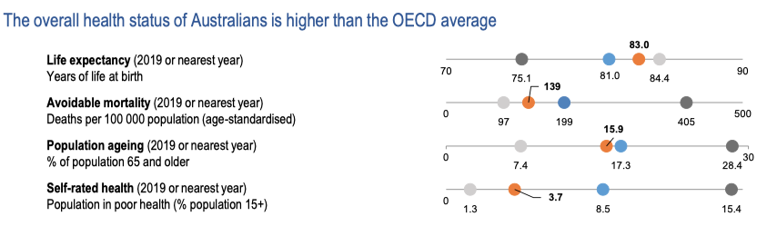
Our Vision
Our vision is that Victorians are the healthiest people in the world.
Health care system performance
Higher
performing
Top-3 average
10-country average
Health at a Glance 2021: OECD Indicators. https://www.oecd.org/health/health-at-a-glance.htm.
Lower
performing
Mirror, Mirror 2021. The Commonwealth Fund

Slide 7
Overview: Victoria’s public health system
Boards and directors are appointed by the Minister
Boards and directors are accountable to the Minister
Minister
Set policy objectives
Determine funding
Overall accountability for the health system
Government
Secretary
Administer legislation and implement policy
Monitor and commission healthcare
Provide governance tools and support
Department of Health
Health Service Board
CEO and Executive
Monitor effectiveness
Ensure alignment of policy objectives and community/stakeholder needs
Act in the best interests of the organisation
Health Services
Patients, consumers, carers and the community
Expect safe, effective care
Define the different needs within the community
Population

Slide 8
Roles | Department of Health and Health Boards
Role of the Department
Role of Boards
Setting policy and strategy
Oversight of healthcare system
Commissioning healthcare
Facilitating capital funding
Monitor health services’ performance
Monitoring quality and safety
Monitoring and ensuring delivery of policy and strategic priorities
Set strategic directions and goals
Set the tone and culture of the organisation
Foster partnerships and collaborations
Oversight of the health service
Prioritise resource allocation
Determine risk appetite and oversee risk management
Enable and monitor CEO performance

Slide 9
Roles | Health services in Victoria
56 Public Hospitals
19 Public Health Services
6 other major entities
Ten sub-regional health services
Eight local hospitals
Thirty small rural health services
Seven multi purpose services
Two early parenting centres
Six regional public health services (e.g. Bendigo Health, Albury Wodonga Health)
Eight major metropolitan services (e.g. Eastern Health, Austin Health)
Five state specialist services (e.g. the Royal Children’s Hospital, the Royal Eye and Ear Hospital)
Ambulance Victoria
Victorian Institute of Forensic Mental Health (Forensicare)
Health Purchasing Victoria (HealthShare Victoria)
Three denominational hospitals (e.g. St Vincent’s Hospital)

Slide 10
About the Department of Health

Slide 11
Organisational structure
Secretary
Euan Wallace
Aboriginal
Health
Nicole McCartney
Chief Aboriginal Health Advisor
Commissioning and System Improvement
Louise McKinlay
Acting Deputy Secretary
Mental Health and Wellbeing
Katherine Whetton Deputy Secretary
Public Health
Zoe Wainer
Deputy Secretary
Health Infrastructure Chris Hotham
Deputy Secretary
Safer Care Victoria
Mike Roberts, CEO
Reform and Medical Research
Victorian Agency for Health Information
Lance Emerson, CEO
Nicole Brady
Deputy Secretary
Regulatory, Risk, Integrity and Legal
Jacinda De Witts
Deputy Secretary
Corporate Services
Daen Dorazio
Deputy Secretary

Slide 12
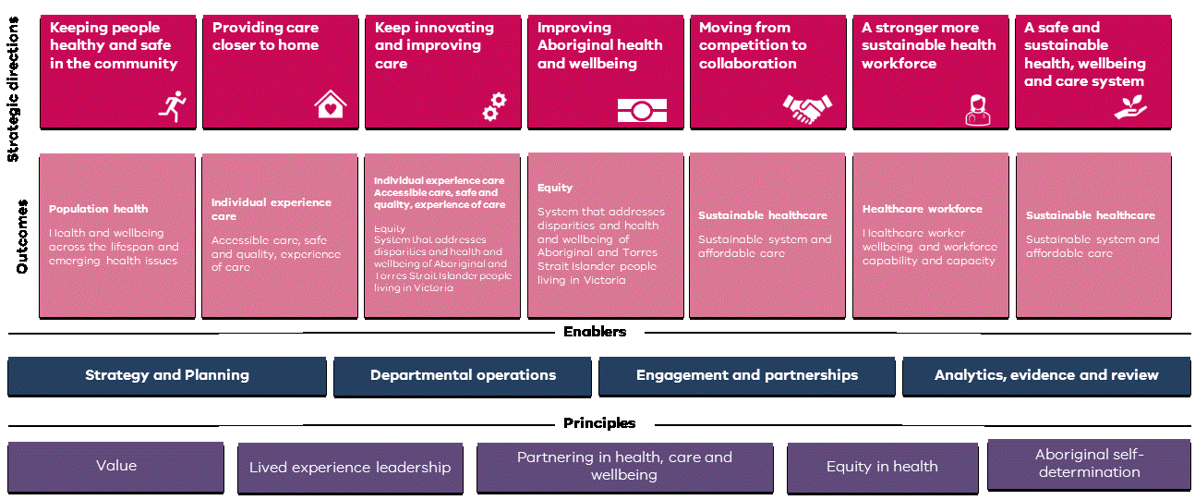
Strategic Plan 2023-2027

Slide 13
Our guiding principles
Value – Make the best use of resources to deliver great health outcomes
Lived experience leadership – Accessible care, safe and quality experience of care
Partnering in health – Decisions about health involve consumers, professionals, families, carers, and communities
Equity in health care – All Victorians can access culturally safe care and expect positive health outcomes
Aboriginal self-determination

Slide 14
Strategic Directions
Keep people healthy and safe in the community
Providing care closer to home
Keep innovating and
improving care
Improving Aboriginal health and wellbeing
Reduce harm, collaborative early intervention and prevention, improve health literacy
Build integrated care and pathways, invest in digital care, support access for chronic disease, improve health outcomes for rural areas
Improve outcomes that matter to patients by improving care experience, accelerate research, design better environments
Strengthen access to culturally safe services, Aboriginal voice through legislation
A stronger more sustainable health workforce
A safe and sustainable health. Wellbeing and care system
Moving from competition
to collaboration
Improve integrated planning and design, system reform through string effective partnerships, better connected and integrated services
World-leading employee experience, supply of critical roles and strengthen rural workforce, future and fit fir purpose capabilities
Financial sustainability, operational performance, Values based healthcare. Long term outcome based resourcing for Aboriginal health services, energy efficient precincts

Slide 15
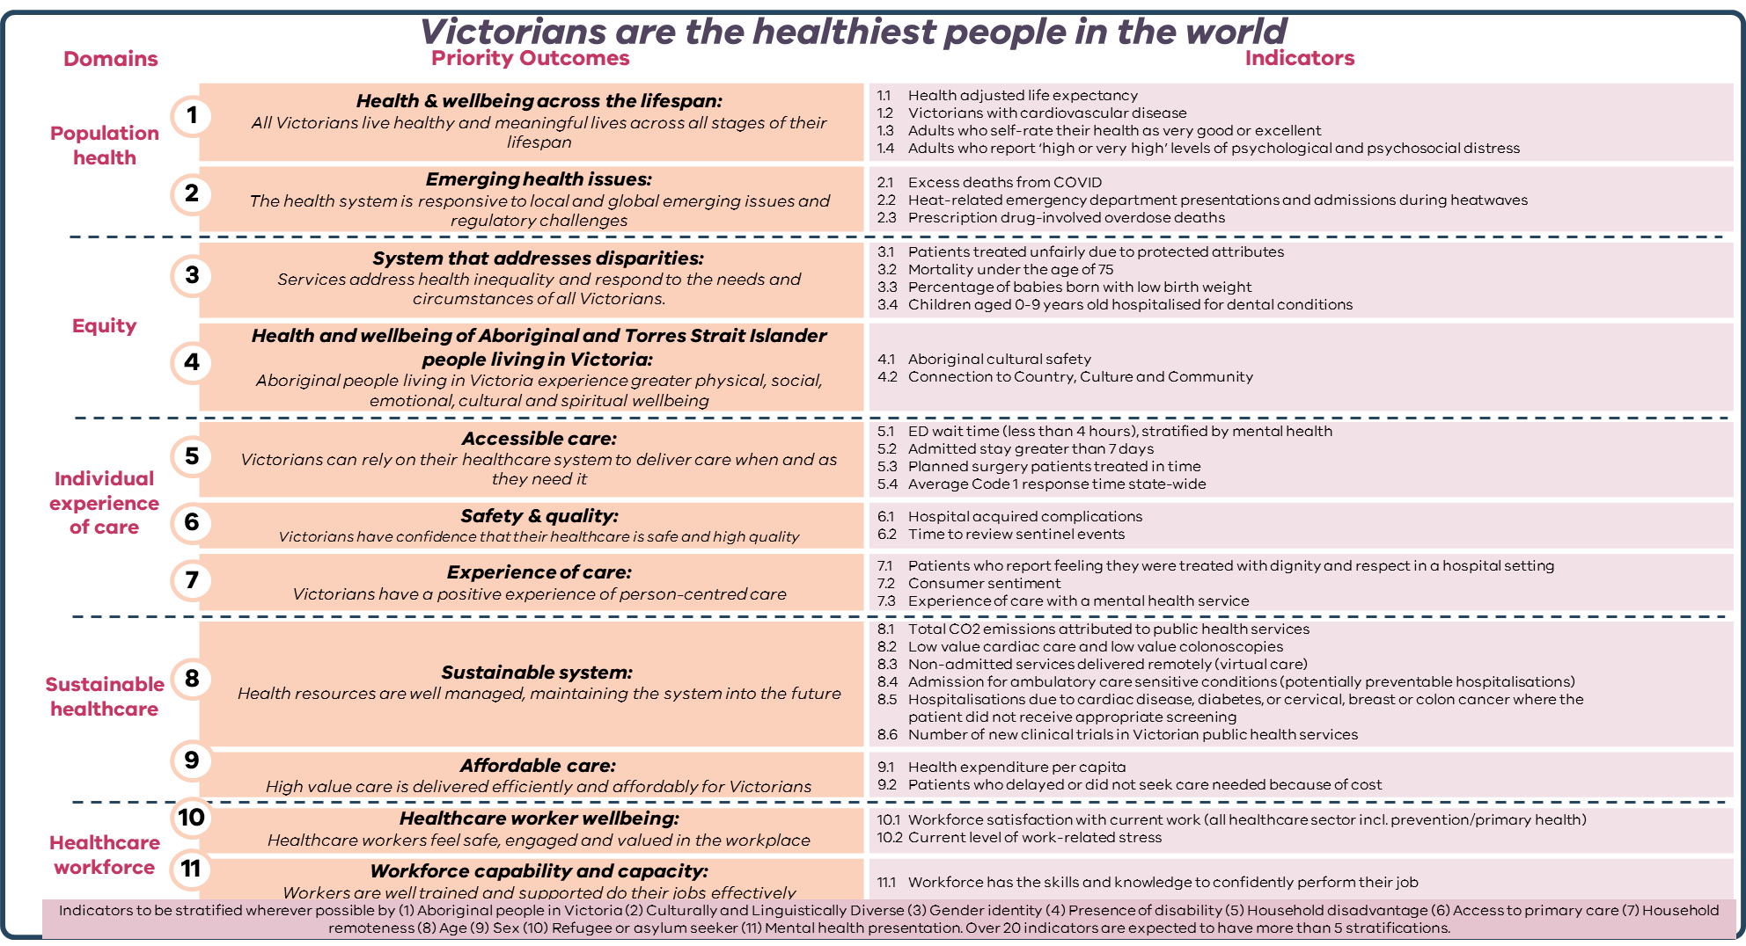
Priority Outcomes Framework

Slide 16
Commissioning and System Improvement
Health Service Operations Executive
Deputy Secretary
Louise McKinlay (Acting)
Senior Executive Director, Health Services, Aged Care & Community Performance
Ryan Heath
Senior Executive Director, System Improvement
Louise Galloway (Acting)
Senior Executive Director, Funding and Insights
Denise Ferrier
Executive Director
South East Health Services and Emergency Response
Executive Director
North East Health Services,
Governance and HealthShare
Executive Director
Western Health Services and Aged Care and Community Performance
Director
Mental Health & AOD Workforce
Executive Director
Community Based Health Services, Policy & Improvement
Executive Director
Workforce Strategy & Wellbeing
Health Services & Aged Care Policy,
Improvement and Engagement
Executive Director
Funding Policy, Accountability Data Insights
Executive Director
Financing and Investment
Executive Director
Project Management and Governance
Chief Digital Health
Officer
Executive Director
Surgical Recovery and Reform
Executive Director, Ambulance, Emergency Care and Access
Director
South East Health Services
Director
North East Health Services
Director
Western Health Services
Director Program Improvement
Cancer Services
Director
Health Workforce Policy
Director
Priority Population Groups & Communities
Director
System Analysis
Director
Investment and Health Sector Budgeting
Director
Project Management Office
Director
Health Sector Assurance
Director
Reform and Engagement
Director, Ambulance Services
Director
Hospital
Capacity and Streaming
Director
Governance & HealthShare
Director
Aged Care & Community Performance
Director
Primary, Community & Oral Health
Director
Health Workforce Investment & Safety
Director
Public Fertility
Care & Community Hospitals
Projects
Director
Funding Policy and Accountability
Director
Connecting Care
Director
Reporting and Governance
Director, Emergency Care and Access
Executive Director
Health Service
Collaborations
Director
Primary Care System Improvement
Director
Health Workforce Strategy
Director
Health Services and Ageing
Director
Applications and Services
Project Director
Emergency Demand (TL)
Project Director Community Pharmacy Prescribing Pilot
Health Sector information Security Officer & Incident Manager (STS)

Slide 17
Role | Commissioning and System Improvement
Role of the Department
Role of CSI
Setting policy and strategy
Oversight of healthcare system
Commissioning healthcare
Facilitating capital funding
Monitor health services’ performance
Monitoring quality and safety
Monitoring and ensuring delivery of policy and strategic priorities
Support the setting policy and strategy
Lead the oversight of healthcare system
Lead the commissioning healthcare
Support the facilitating capital funding
Lead the monitoring of health services’ performance
Support monitoring quality and safety
Support the monitoring and ensuring delivery of policy and strategic priorities

Slide 18
Clinical Governance for Health Service Board Directors
July 2023
Sarah Fischer, Director of Culture & Capability

Slide 19
Safer Care Victoria
Our aim: To improve healthcare across Victoria, so it is safer, more effective and person-centered, aligned with the Victorian Clinical Governance Framework.
Our purpose: To enable all health services to deliver safe, high-quality care and experiences for patients, carers, and staff.

Slide 20
Structure of Safer Care Victoria
Safety
Improvement
Operations
Clinical and Professional Leadership

Slide 21
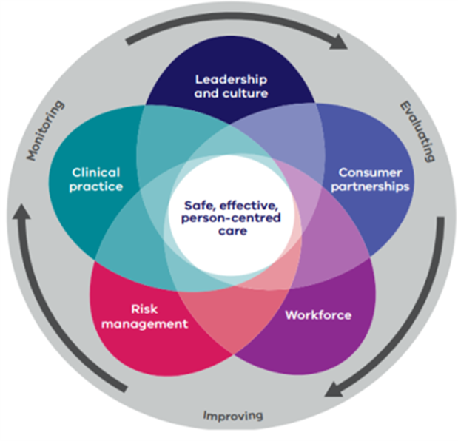


Why are we here?
2016
2021
21

Slide 22

Importance of Clinical governance
Demystifying clinical governance is really important. Clinical governance is just corporate governance in a clinical organisation…it is important to remember your core business is delivering best care all the time…you don’t need to be a clinician to be a director.
Ken Gray, Central Highlands Rural Health Board and member of SCV Applied Clinical Governance Working Group

Slide 23
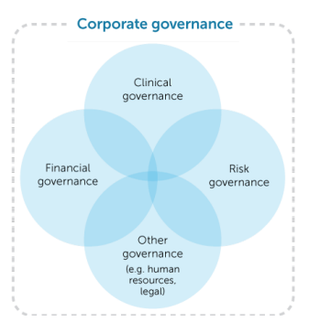
Corporate Governance vs Clinical Governance
Corporate Governance
Clinical Governance
The system of rules, practices, processes, leadership and culture, by which an organisation is directed and monitored.
The system of rules, practices, processes, leadership and culture that helps us to deliver safe healthcare.

Slide 24
Why does this matter?
Patient harm is one of the 10 leading causes of death and disability.
While in hospital, one in every 10 patients is harmed. 50% of these incidents are preventable.
15% of health spending is wasted dealing with adverse events.
The World Health Organisation ‘10 Facts on Patient Safety’ (2019).

Slide 25
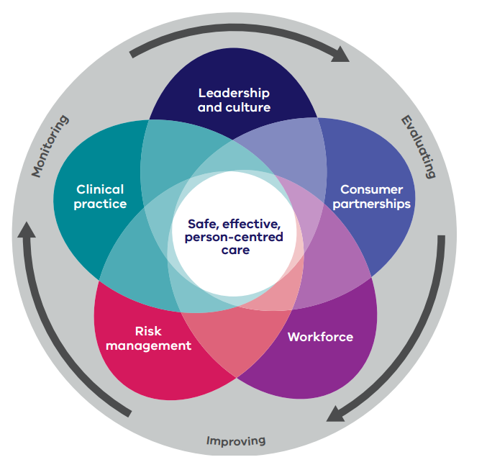
Board Members’ Roles and Responsibilities
    Lead and model a supportive, transparent, just culture that assists all health service staff to provide high-quality care and continuously improve
    Ensure that the organisation’s operations and resource allocation decisions remain aligned to its purpose and strategy → safe, effective, and person-centred patient care
    Understand the Victorian Clinical Governance Framework and concepts (five clinical governance domains)
(SCV, 2017)

Slide 26
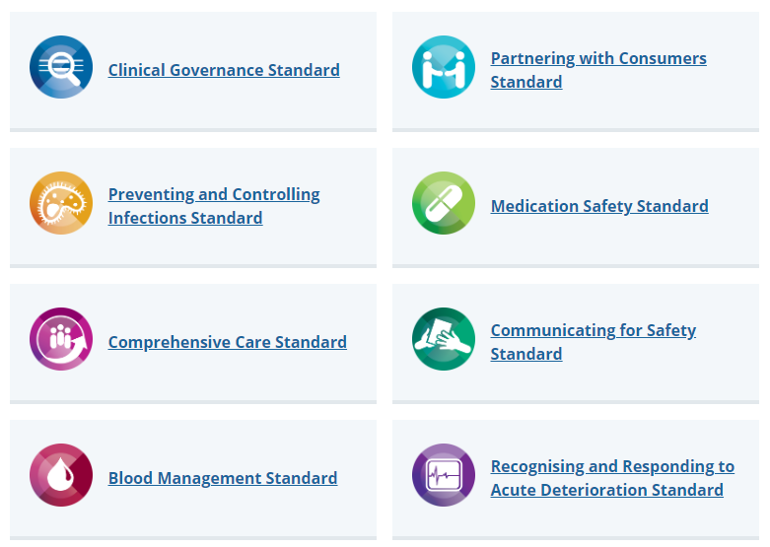
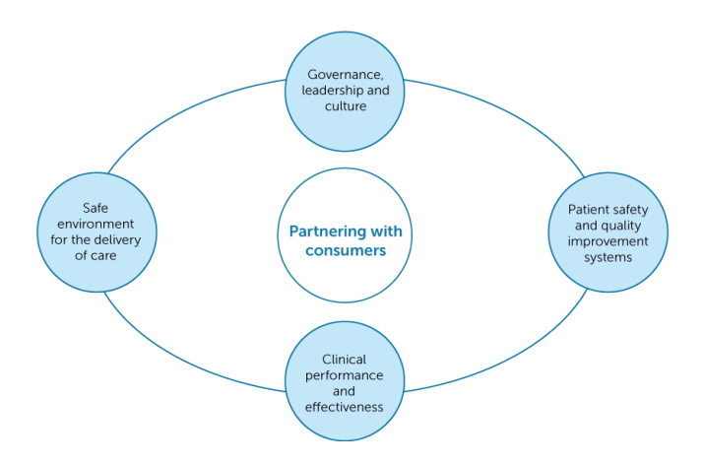

Australian Commission on Safety and Quality in Health Care

Slide 27
Most important role is to ask questions about organisational culture, e.g., ways of working, norms, and, behaviours.
Does everyone understand the importance of patient safety?
Do we really have an open and fair culture?
Are we actively encouraging reporting of incidents?
Do we get the right information?
Do we learn from patient safety incidents?
Are we always open when things go wrong?
Are we actively implementing recommendations and taking action from safety signals?

Slide 28
Information & data analysis
Monitor
How safe are we?
Detect
Trends
Respond
What’s happening in the system?
How can we intervene to improve?
Variation
How do we know?
Board reports
Benchmarks
Astronomical events

Slide 29


Essential reading

Slide 30

Next steps
Attend the SCV Board & Executive Clinical Governance Induction
2–3-hour virtual facilitated sessions held between August – November 2023
    Victoria’s Clinical Governance Framework
    Data interpretation
    Case studies
    Your role and responsibilities.
  e. culture.capability@safercare.vic.gov.au
  We will contact you shortly.

Slide 31
Quality and Safety for Board Directors
Professor George Braitberg AM
Chair, Quality and Safety Subcommittee
Peter MacCallum Cancer Centre Board
Boards Ministerial Advisory Committee
Member

Slide 32
The board’s role
The board is ultimately accountable for the clinical governance system and
the clinical care provided by the organisation.
Prioritising
Embedding
Building confidence
Enabling
Analysing
Responding
The Board Quality Committee is a formal Committee of the Board established in accordance with section 65S of the Health Services Act 1988 (Vic) to facilitate the discharge of this duty on behalf of the Board.

Slide 33
Information for the board
Monitor
How safe are we?
Detect
Respond
What’s happening in the system?
How can we intervene to improve?
Trend
How do we know?
Board reports
Benchmarks
Thematic analysis via incidents and feedback
Have we done what we have said we would need to do – are our recommendations SMART?
Variation

Slide 34
Quality Committee TOR – should be aspirational but achievable
Setting a level of aspiration for the clinical quality and patient/consumer experience of services provided by your organisation
Ensuring that effective and accountable systems are in place to monitor and improve quality and effectiveness while reducing the risks associated with healthcare delivery, by:
  ensuring compliance with relevant laws, regulations, standards and codes and
  embedding continuous improvement, innovation and evaluation metrics, and
Ensuring your organisation complies with relevant external accreditation and certification programs
Ensuring that any systemic problems identified with the quality and effectiveness of your health services are addressed at an organisational level

Slide 35
TOR
Should reflect the strategic aims of the organisation
Should include terms of appointment
Should include meeting frequency
Should include an evaluation process
Should include a time to review the TOR

Slide 36
Membership
The members of the committee are:
  Chair (Board Director)
  Other Board Directors (at least one)
  Chief Executive (or Acting Chief Executive when absent)
  Chief Operating Officer
  Executive Director of Quality if not CMO or CNO who are members in their own right,
  Director, Quality and Safety
  Director Allied Health
  Divisional Directors (clinicians; medical and nursing) number dependant on org structure
  Community/consumer representative(s).
An external expert may be appointed to provide an independent perspective.

Slide 37
What do you cover in a Board Quality Committee?
Patient Story
Quality Committee Work Plan
Quality and Safety Report
        KPIs, should be presented in a way that trends are identified
        Ideally mapped back to Accreditation Standards to ensure “SNAP” ready
        Adverse safety events (high level report summary and recommendations). Periodic trend analysis
        Feedback report, high level summary of any “complex complaints”. Periodic review of trends, VHES (benchmarking) and any internal patient surveys
4. Showcase improvement and innovation across the organisation.

Slide 38
What do you cover in a Board Quality Committee
5. Clinical Risk Register and Risk Management
      Endorse changes to the risk register proposed by subject matter experts
      Monitor the implementation of recommendations from RCA of incidents
6. Clinical processes
New models of care, application of technology to improve quality and safety etc. Promote codesign with consumers and engagement of vulnerable populations and ATSI groups
7. External Reports
  PRISM and Monitor provide opportunities to benchmark
    Many aspects of quality reported
    Quarterly reports
8. Consider recommendations regarding workforce requirements related to quality and safety

Slide 39
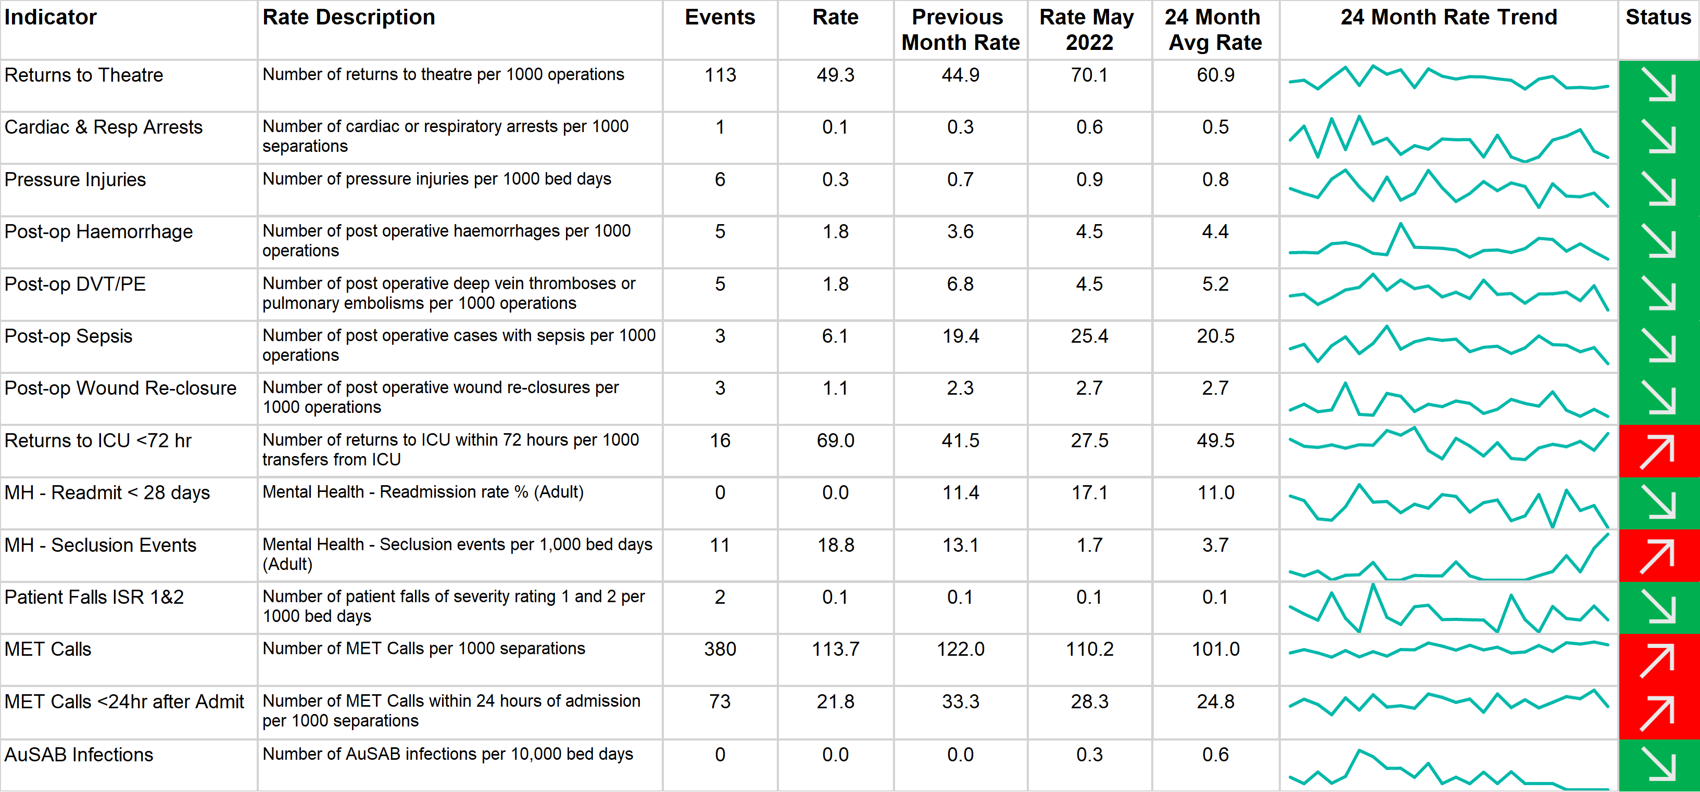
Quality and Safety Summary Data – Hospital A

Slide 40
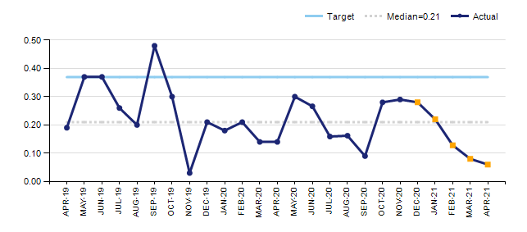
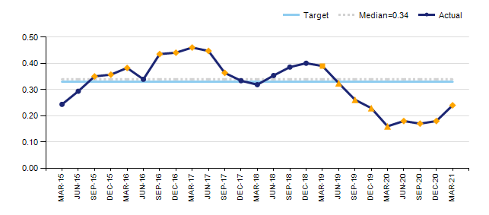
Trends and targets are important – Hospital B
Data point is part of a shift(◆)
Data point is part of a trend(◼)
Data point is part of a shift and trend(▲)

Slide 41
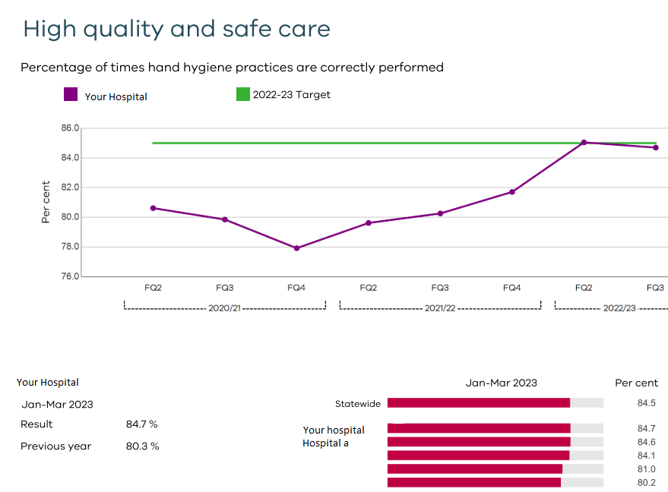
Example from the Monitor Report - Benchmarking

Slide 42
How it works
Set up an agreed means of communication ensuring Board Chair and CEO are informed
Meet with Key Exec (F2F and virtual) to created workplan, mapped back to strategic outcomes
Exec to provide draft agenda
Papers to be provided a week before meeting
Opportunity to question and clarify prior to meeting – don’t want to “ambush” at the meeting
Board monitors, sets up expectations, directs Exec when needed but does not micromanage and should not get involved in operational issues

Slide 43
Conclusions
It is a privilege to be on a Board Quality Committee
The committee has a significant amount of interaction with clinicians
The business of safe, timely, effective person centred care is the focus
It should be used to highlight innovation and best practice and celebrate the work that teams are doing
Increasingly it will need to have a lens of staff welfare as it impacts on care delivery
It has an important role in ensuring the organisation is accreditation ready

Slide 44
New Board Director Perspective
Ms Robynne Cooke
Director,
Northeast Health Wangaratta board

Slide 45
Tips and Hints
Information available – plans!
    Strategic plan, quality plans, RAP, minutes, annual report, capital plans
Orientation
    Meet Executive – you should have a formal time
    Meet other board members
    Skill sets – yours and theirs
    Visit – visit other sites
    Board buddy?
    History – current issues – recent reviews?

Slide 46
Commit
Zoom or face to face – assists with the orientation
Read papers – ask questions
Health dictionary! – understand what you are reading
Board document system
Be active – represent the board at functions – Annual General Meeting
Care first rounds – walk through the organisation
In camera sessions
Understand risk and risk appetite

Slide 47
Your development
Coaching
Attend education sessions in the beginning and ongoing
Sponge - you have been recruited for your skill set to compliment
Formal governance courses
Why are you there?

Slide 48
Pitfalls to avoid
You are not the CEO
Swim lanes very important
Understand the roles – Board Chair
    Gateway to the CEO
    Check in
  Chair a meeting? – not everyone can
Silence does not = agreement
Worlds colliding

Slide 49
Sub committees
You cannot be on all – nomination process
Heavy lifting – ask questions
Observer via the Board Chair
Board meeting – feedback is very important
Consistent documentation / agendas / minutes
Red flags if you are not getting the information

Slide 50
Feedback
Check in with the Board Chair
Evaluation of Board and Board Subcommittees
What can go wrong
    Governance - policies
    Quality and Safety
    Finance

Slide 51
Question and answer session

Slide 52
Resources for board directors
Victorian Public Sector Commission: The commission promotes high standards of governance, accountability and performance for Victorian public entities, including health service. Resources are available at: https://vpsc.vic.gov.au/governance/
The Directors’ Toolkit: The toolkit provides essential information on the public health sector environment and is available at: https://www2.health.vic.gov.au/hospitals-and-health-services/boards-and-governance/education-resources-for-boards/directors-toolkit.
The Integrity Governance Framework: The integrity governance framework and better practice assessment and reporting tool are resources to assist Victorian public health services in assessing their integrity risks. Available at: https://www2.health.vic.gov.au/about/publications/policiesandguidelines/Integrity-governance-framework-and-assessment-tool-resources

Slide 53
Future sessions
Session 2: Organisational culture, leadership and legal responsibilities
Tuesday 15 August 2023, 4:00 – 5:15pm
Session 3: Accountability, funding and Risk Management
Wednesday 20 September 2023, 4:00 – 5:15pm

Slide 54
Appendices
Appendix 1: page 39 Table: Example from the Monitor Report – Benchmarking: High quality and safe care
The table shows an example of hospital-acquired complication data. The first two columns are complication indicators and rate description. The other columns include events, rate, previous month rate, previous yearly and average 24-month rate which have been blanked out to de-identify the hospital. Following these columns are line graphs showing a 24-month rate trend per complication. The last column shows the status in terms of decreased/increased rates of complication—colour-coded in green/downward arrow for decreased incidence and red/upward arrow for increased incidence.
Appendix 2: page 40 Graph: Trends and targets are important – Hospital B
The line graph is showing an example of hospital safety and quality trends and target. Incidence percentage is shown on the y-axis in decimals from 0.00 to 0.50, while the x-axis represents months from April 2019 to April 2021. The data points are identified if they are part of a shift (by a diamond), part of a trend (by a square), or by both shift and trend with a triangle. The graph also shows the target point at around 0.38 and the median of 0.20 across all months.
Continued on next page.

Slide 55
Appendices continued
Appendix 3: page 41 Graph: High quality and safe care
The line graph is titled ‘High quality and safe care’ which is an example of a benchmark monitoring report. It describes the percentage of times hand hygiene practices were correctly performed. The y-axis shows the percentage from 76.0 to 86.0 in increments of 2.0. The x-axis identifies the fiscal quarter periods for the years 2020-2021, 2021-2022, and 2022-2023. The target for 2022-2023 is set at 85.0. Below the line graph is a bar chart that compares the hospital’s performance in terms of incidence of hand hygiene practice with that of statewide benchmark and that of other hospitals. The x-axis represents the statewide benchmark and hospital names, while the y-axis represents the corresponding percentages. There is also a table summarising of the hospital performance results for January-March 2023 at 84.7% versus the previous year which was marked at 80.3%.

Slide 56
Accessibility statement and publisher information
  To receive this presentation in another format, email Health Service Governance <healthservicegovernance@health.vic.gov.au>.
  Authorised and published by the Victorian Government, 1 Treasury Place, Melbourne.
  © State of Victoria, Australia, Department of Health, September 2023.
  Except where otherwise indicated, the images in this presentation show models and illustrative settings only, and do not necessarily depict actual services, facilities or recipients of services.
  Available at Information and education for health service boards <https://www.health.vic.gov.au/share_link/5c310551-7faf-4489-bca8-dbc0f678fe60/12699>

