Slide 1
Induction Training for board directors
Session 3
Accountability, Funding and Risk Management
Facilitator: Joanna Flynn, Chairperson, Boards Ministerial Advisory Committee
20 September 2023

Slide 2
Session 3 – Accountability, Funding and Risk Management
Accountabilities overview
Joanna Flynn – Chairperson of BMAC
Funding and Accountabilities
Richard Bolitho, Executive Director, Financing and Investment, Department of Health
Board financial oversight
Lance Wallace – Chairperson, HealthShare Victoria
Risk Management
Cath Bowtell – Chairperson, The Royal Women’s Hospital
Rural Health Service Lens
Peter Matthews – Chairperson, Portland District Health
Question and Answer
Facilitated by Joanna Flynn – Chairperson of BMAC

Slide 3
Accountabilities for health service board directors
Joanna Flynn, Chairperson, Boards Ministerial Advisory Committee

Slide 4
Overview
Boards and directors are appointed by the Health Minister and are accountable to the Minister for Health
Boards and individual members are appointed as public officials and must act in good faith and in the public interests of the health service
Board responsibilities include setting the strategic direction; ensuring accountability of the health service; shaping organisational culture; employing, monitoring and working with the CEO
This session will cover the funding, accountability mechanisms and risk management oversight led by the board

Slide 5
Funding and Accountability
Richard Bolitho, Executive Director, Financing and Investment, Department of Health

Slide 6
Accountability framework
What services is my entity required to deliver?
  Statement of Priorities (SoP)
  Tripartite Agreement (for multi-purpose services)
  Specific grants
How much will the service be funded and what are the conditions?
  Performance and Funding Guidelines (PFG)
  How will the department monitor my performance?
  Performance Monitoring Framework (PMF)

Slide 7
Statement of Priorities (SoP)
  Key accountability document about how the department funds and monitors health services for the year, as well as aligning with government strategic priorities.
  Annual agreements between health service boards and the Minister for Health and are required under Health Services Act 1988.
The SoP has four main parts:
        Part A Provides an overview of the service profile, strategic priorities and deliverables the health service will
        achieve in the year ahead.
        Part B Lists the key financial, access and service performance priorities and agreed targets
        Part C Lists total funding and associated activity that form the Health Services Financial Year Budget
        Part D Activity and funding figures include Victorian and Commonwealth funding contributions through the National
        Health Reform Agreement. Only includes funding and activity that is in-scope for Commonwealth revenue
Reviewed annually to align with policy change and the Performance Monitoring Framework
Outcomes reported in each health service’s annual report and tabled in Parliament
Not all services have a SoP, but all have an equivalent agreement.

Slide 8
Policy and Funding Guidelines (PFG)
The Policy and Funding Guidelines represent the system-wide terms and conditions (for funding, administrative and clinical policy) of funding for health services in Victoria.
The Policy Guide provides operational and service delivery policy and obligations, standards and requirements to which funded organisations are expected to adhere.
The Funding Rules outlines the budgetary, funding and activity parameters that funded organisations are expected to work within.
Reviewed annually to align with policy changes and State Budget outcomes and commitments.

Slide 9
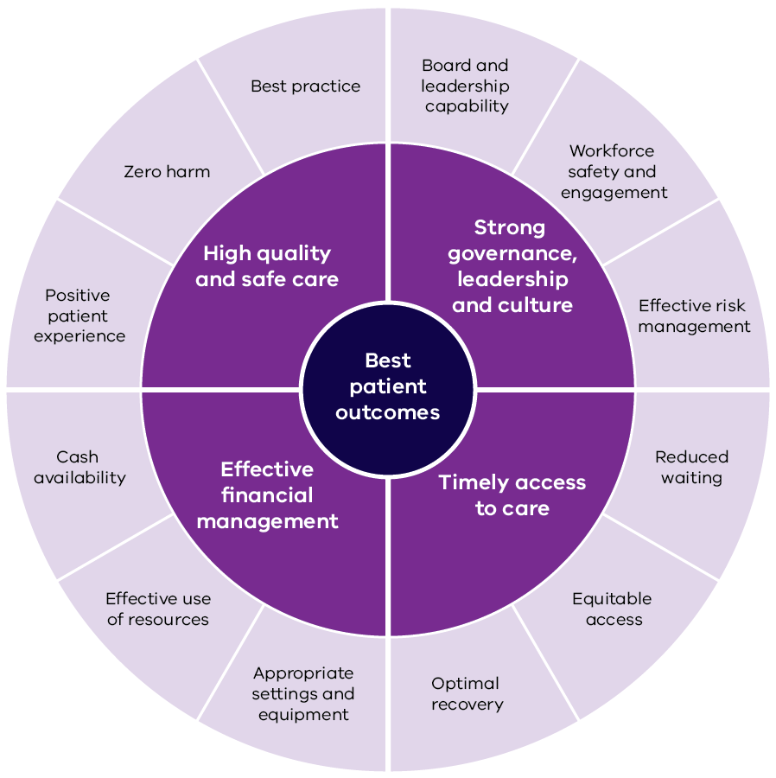
Performance Monitoring Framework (PMF)
The PMF describes how the department monitors the performance of health services in Victoria.
Its purpose is to promote transparency and accountability for performance
improvement across the system.

Slide 10
Public accountability
Annual Report – VAGO audit, tabled in Parliament by Minister
Standing Directors – set the standard for financial management
Authorised officer – part of your delegation
Attestations required by CEO and Board Chair
    eg. Financial Statements, Integrity
Annual General Meeting – accountability to your community

Slide 11
Funding sources

Slide 12
Activity Based Funding (ABF)
ABF accounts for approximately 73 per cent of hospital funding in Victoria.
It is a way of funding hospitals based on the number and mix of patients they treat.
Health Services are paid a set price per unit of activity delivered.
The unit used to count activity in Victoria is the National Weighted Average Unit (NWAU)
ABF funding provides clear parameters with which to apply recall and throughput policies. Where health services:
under-deliver against activity targets, funding can be ‘recalled’, and
exceeds expectations additional funding can be provided subject to an agreed set of policy parameters. These parameters are outlined in the PFG.
National Weighted Activity Unit (NWAU)
Price
Funding provided
X
=

Slide 13
Block funding
Block funding is the second most common funding model for hospitals.
A fixed amount, or ‘grant’, is provided for the delivery of services.
In the instance of hospital funding, Health Services are still expected to deliver a range of services, but these are less reporting intensive in nature.
Victoria uses block funding grants when ABF funding does not sufficiently cover the cost of delivery.

Slide 14
Aged Care Reform
In response to the Final Report of the Royal Commission into Aged Quality and Safety, the Commonwealth is introducing a range of reforms to the Aged Care sector including:
        Establishment of the Independent Health and Aged Care Pricing Authority (IHACPA)
        Introduced a new funding model (AN-ACC)
        Registered Nursing 24/7 Requirements
        Care Minutes and RN Care minutes Requirements
        Star rating system for Residential Aged Care
        Code of Conduct for providers, staff and health care providers
        Strengthened Governance of Approved Providers
        Improved Information sharing through digital health initiatives
        Addressed overuse of restrictive practices in residential aged care facilities

Slide 15
Residential Aged Care Funding
Commonwealth payments
AN-ACC Funding Model Changes
Residential aged care across Australia is funded and regulated by the Commonwealth Government under The Aged Care Act 1997 (Cwth).
From 1st October 2022, the Commonwealth replaced the former funding instrument (ACFI) and the related subsidies, with AN-ACC. This changes how the ‘Care’ and ‘Hotel’ components of aged care is funded.
Total facility payment =
Fixed Component
Facility Base Care Tariff
NWAU X price X bed days
Variable Component
Sum (NWAU X price X bed days) for all residents
Adjustment Component
One off adjustment
NWAU X price X Number of new residents
1 National weighted activity unit (NWAU) = $243.10
Supplements
The Commonwealth pay a range of supplements depending on specialist clinical need, such as continuous oxygen supplement or individual circumstances, such as the homeless person supplement

Slide 16
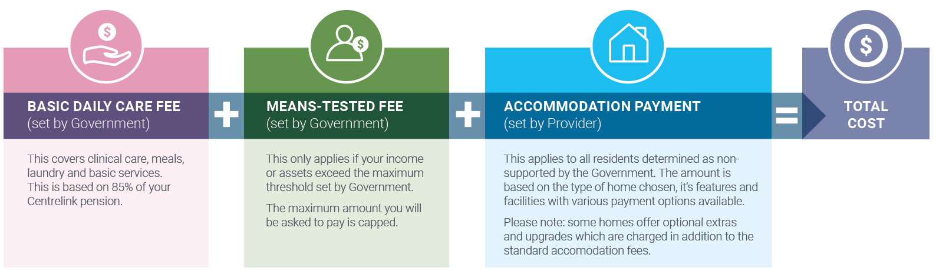
Resident payments

Slide 17





Residential Aged Care Funding
The Victorian Government pays a range of subsidies to PSRACS to ensure rural viability, care of complex clients and support a skilled workforce. Due to Commonwealth funding changes, such as the removal the Adjusted Subsidy Rate, the department are reviewing the distribution of the Victorian subsidy funding to achieve policy objectives of the department.
Adjusted Subsidy Reduction
High Care Supplement
Low Care Supplement
Mental Health Supplement
Other Supplements
Responds to former discounted payments by the Cwth
Covers PSRACS recognised as high care facilities**
Covers PSRACS recognised as low care facilities**
Covers PSRACS that provide specialist adult mental care
Covers refurbishment and other small grants to PSRACS
**High and low care facilities are defined under The Safe Patient Care (Nurse to Patient and Midwife to Patient Ratios) Act 2015 (VIC).

Slide 18
Annual health service budget allocation overview

Slide 19
Thank you
Richard Bolitho, Executive Director, Financing and Investment, Department of Health

Slide 20
Board financial oversight
Lance Wallace, Chairperson, HealthShare Victoria

Slide 21
Legislative framework
Directors’ responsibilities flow from:
Health Services Act
State financial legislation
  Financial Management Act
  Audit Act
  Standing Directions of the Minister for Finance.
Directors need to act in a financially responsible manner:
Exercise care with public funds and assets;
Comply with legislation and Standing Directions; and
Demonstrate due diligence

Slide 22
Role of Board and Committees
Under financial legislation, the Board is responsible for financial stewardship.
Board Committees enable a Board to effectively structure their workload by delegating a more comprehensive examination of key strategic and risk issues.
Committees such as Finance and Audit & Risk carry out a thorough analysis of financial reports and make recommendations for the full Board to consider.
Even though committees undertake a more detailed review of issues, it is the Board – and the individual Directors comprising the Board - that remains accountable.
so each individual Board member should ask questions and be satisfied
not rely on an “expert Board member”.

Slide 23
What to focus on
Key financial issues for focus under the Act are:
  (1) Accountability
    Receiving timely, accurate and well presented financial reports
    Seeking responses to issues arising from reports and effective use of audit
    Ensure financial budgets and reports link well to strategy and business plans
  (2) Efficiency
    Ensure funds are used in an efficient and effective manner
  (3) Sustainability
    Manage costs within available revenue in the current and out years
    Maintain enough cash to meet obligations as and when they fall due

Slide 24
Accountability (1)
Accountability:
  Financial reports are regularly and consistently prepared
    The data is considered robust
    Key questions are answered about significant changes or budget variances;
  Issues emerging without warning are understood and addressed;
  Financial risks are reviewed and mitigation actions taken;
    Consider factors within the health services control as well those outside
    Compare practice from like health services (surgery, workforce, revenue, contracts)
    Link finances to operations and staff parameters (eg. activity, staff, overtime, Workcover)
  Allow time to discuss longer term “riskier” actions.

Slide 25
Accountability (2)
  Audit (internal and external) is effectively engaged
    Audit plans are developed to focus on key risk/issues
    Reports and findings are reviewed and addressed
    Follow up actions are clear and monitored
    In camera sessions are utilised effectively
    Awareness of related reporting eg VAGO, IBAC, Ombudsman.

Slide 26
Efficiency
Efficiency:
  Key efficiency metrics monitored
    Existing metrics are reviewed and further developed
    Review of metrics links to the development of improvement plans
  Improvement/Sustainability Plans are developed
    The development of preferably multi-year plans to review current practices and identify potential improvements though automation, practice improvement, tenders etc.
  Benchmarks are reviewed
    Comparative performance to other health services and industry benchmarks

Slide 27
Sustainability – operating result
The key financial metric is the operating result
    Operating revenue less expenses, excluding capital revenue and depreciation.
    This is normally well monitored.
Less well monitored is the position that will be taken into the next financial year – the underlying result
    This needs to consider one-off or declining revenues and one off or increasing staffing or other costs.
Long term sustainability is dependent on a balanced underlying result.

Slide 28
Sustainability - cash
Sustainability is also dependent on managing cash well.
The key issue is to maintain sufficient cash to pay bills as and when they fall due.
Whilst cash is generally well managed, in assessing your cash position you must ensure that committed cash is clearly separated from uncommitted cash.
Some examples of committed cash are:
    Funds received for recurrent or capital projects not yet spent
    Commitment for future capital projects (or contributions to projects)
    Aged care ‘bonds’ use and projection for repayment
    Commitments from associated bodies (research or business activities) which have not been forthcoming.

Slide 29
Tight finances and abnormal conditions
Health services typically manage tight financial positions – due to the funding models design, patient demand, and improvement opportunities.
It will be normal for your health service to run at or close to break even and this should not be a concern.
But, with these tight operation parameters it is critical that the underlying operation position (not just the headline operation position) and uncommitted cash (not just total cash) is carefully managed.
Whilst we all hope that the worst of COVID is behind us, it is also important to note that in an emergency response scenario standard rules will not apply and patient safety and outcomes will always come first. In these situations Boards need to work closely with the department (through Chairs, CEOs and CFOs) and take a pragmatic view of financial management.

Slide 30
Summary
The nature of health service funding is that the financial position will be expected to be tight.
Boards are to openly assess financial position and all available actions.
Finance Committees provide the detailed discussion but the Board is responsible and all members need to contribute.
Assessments need to consider actions within the health service control as well as those where influence is limited.
Financial issues need to be discussed in a constructive way with the department
Need to monitor the current operating position and cash position but also that of next year or three years out.
The Director’s Toolkit gives good information on Financial Governance.

Slide 31
Thank you
Lance Wallace, Chairperson, HealthShare Victoria

Slide 32
Risk management oversight
Cath Bowtell, Chairperson, The Royal Women’s Hospital

Slide 33
Risk Management
Risk is more than a compliance function. A focus on risk, compliance and assurance is a key element of board performance.
Risk is integral to strategy development and performance management. The board should have continual insight into strategic, operational, financial, political and social landscapes that may impact or optimise the health service in achieving its strategic objectives.
Risk appetite is the level of risk the board is prepared to accept.
Risk governance is a range of elements that together provide a framework for managing and monitoring risk.

Slide 34
Board responsibilities
Understand the risk profile and risk culture of the health service.
Set and document the health service risk appetite and tolerances.
Ensure there is a system to monitor, respond and report against the risk appetite.
Regularly evaluate the risk management framework, including the extent to which the framework responds to new and emerging risks and the adequacy of the controls.
Look for outliers.

Slide 35
Key risk areas
Organisational – people, operations, systems (including data security), supply chain and performance
Financial – viability, fraud, and financial performance
Legal/Compliance – accreditation, OH&S
Physical Management – asset performance, disaster exposure
Clinical – provision of safe and high quality care
Integrity – leadership and culture

Slide 36

Integrity Governance Framework
The integrity governance framework is a useful tool to understanding how prepared your organisation is dealing with integrity risks.
Uses the three lines of defence risk model – manage, oversee and assurance.
Provides a simple and effective way to structure integrity governance and risk management.

Slide 37
Risk Framework
Sets out why and how we do risk management
Legislative requirements
Provides staff with guidance
Facilitates a consistent approach to managing risk
Accurate information to inform decision making
Planned, efficient and effective control of risk
Minimise risk exposure

Slide 38
Board Process to Manage Risk
Approve, regularly review, and update the health service’s risk framework
Receive regular updates about key risks and adopt early warning indicators and escalation protocols
Monitor compliance with the Victorian public health sector policies
Ensure there is a comprehensive risk register of current and emerging operational and strategic risks

Slide 39
Thank you
Cath Bowtell, Chairperson, The Royal Women’s Hospital

Slide 40
Rural Health Service lens
Peter Matthews, Chairperson, Portland District Health

Slide 41
The same but different…
The same - all health services, large or small:
are part of the Victorian Government’s public health system.
have the same obligations as set out in this forum regardless of their scale or demography or geography.
have an obligation to community(s) however defined for their entity.

Slide 42
The same but different… continued
The different:
small rural services are closer to their communities - they can set the disposition of a community - fair, open, aimable, civil, affable.
closeness may give greater understanding but also may heighten prejudices, embed mythologies, claim uniqueness - while closeness is helpful it is neither the primary nor only lens.
it is 'our' service - local ownership is commendable but can be convenient justification for unusual behaviour; more correctly a rural health service is 'for' the community provided by the Victoria Public Health system.
greater possibility of conflict of interest for board and executive ... beware.
fewer staff, thus possibly less expertise ... work with your colleague entities - local, sub-regional, regional and metro - formal, informal, partnerships - all will assist if they can, if they are asked.

Slide 43
Thank you!
Peter Matthews, Chairperson, Portland District Health

Slide 44
Resources
Victorian Public Sector Commission: https://www.boards.vic.gov.au/risk
The Directors’ Toolkit: https://www.health.vic.gov.au/boards-and-governance/directors-toolkit
Funding, Accountability and Monitoring:
https://www.health.vic.gov.au/hospitals-and-health-services/funding-performance-and-accountability
Integrity Governance Framework: https://www.health.vic.gov.au/publications/integrity-governance-framework-and-assessment-tool-resources
VMIA Training Resources https://www.vmia.vic.gov.au/training/our-offerings

Slide 45
Aged Care Resources
Funding for residential aged care (subsidies and supplements):
https://www.health.gov.au/our-work/residential-aged-care/funding
Funding for aged care service providers:
https://www.health.gov.au/topics/aged-care/providing-aged-care-services/funding-for-aged-care-service-providers
Australian National Aged Care Classification (AN-ACC) funding model:
https://www.health.gov.au/our-work/AN-ACC

Slide 46
Accessibility statement and publisher information
  To receive this presentation in another format, email Health Service Governance <healthservicegovernance@health.vic.gov.au>.
  Authorised and published by the Victorian Government, 1 Treasury Place, Melbourne.
  © State of Victoria, Australia, Department of Health, September 2023.
  Except where otherwise indicated, the images in this presentation show models and illustrative settings only, and do not necessarily depict actual services, facilities or recipients of services.
  Available at Information and education for health service boards <https://www.health.vic.gov.au/share_link/5c310551-7faf-4489-bca8-dbc0f678fe60/12699>

