Slide 1
Subcutaneous immunoglobulin (SCIg)
‘Getting started’
November 2023
OFFICIAL

Slide 2
Acknowledgement of Country

Slide 3
Content
What is SCIg? Patient selection
Approved indications for SCIg in Australia Contra-indications
Comparison of SCIg and IVIg Products and vials
Why SCIg might be preferred Ordering SCIg - BloodSTAR
Patient’s preference Patient education
Eligibility requirements Equipment: pumps and consumables
Governance and other considerations Documentation
Commencing a program

Slide 4
What is SCIg?
Subcutaneous immunoglobulin
Immunoglobulins (also known as antibodies), are glycoprotein molecules produced by plasma cells (white blood cells). They act as a critical part of the immune response by specifically recognising and binding to particular antigens, such as bacteria or viruses, and aiding in their destruction.
    Normal IgG level 7 – 12 g/L (this may vary slightly between laboratories)
Produced by fractionation of donated human plasma
The main immunoglobulin in SCIg is IgG (approx 98%)
Human immunoglobulins have been used to treat hypogammaglobulinaemia since the 1950s
SCIg has been available since the 1980s in USA and Europe but with limited acceptance initially, now widely used in USA, Europe and UK
Licenced by NBA in Australia in 2013

Slide 5
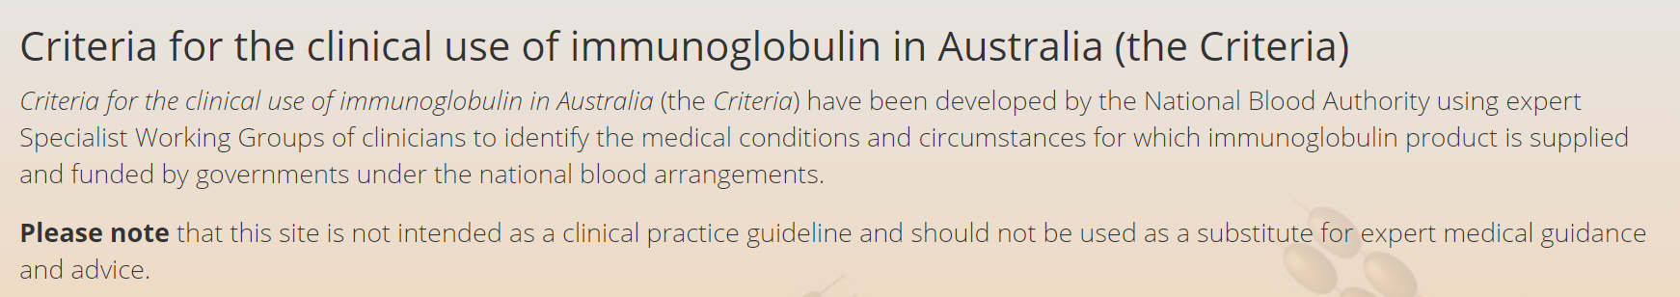
Approved indications for SCIg in Australia
Primary immunodeficiency diseases with antibody deficiency
Specific antibody deficiency
Acquired hypogammaglobulinaemia secondary to haematological malignancies, or post-haemopoietic stem cell transplantation (HSCT)
Secondary hypogammaglobulinaemia unrelated to haematological malignancies, or post-haemopoietic stem cell transplantation (HSCT)
Chronic inflammatory demyelinating polyneuropathy CIDP
https://www.criteria.blood.gov.au/

Slide 6
Comparison table between SCIg and IVIg
Issue | SCIg | IVIg
Who can have it? | Meet SCIg criteria | Meet IVIg criteria
Where | Patient’s home – self or carer administered | Hospital – health professional administered
Route | Subcutaneous; abdomen, thigh, upper arm | Intravenous
Lifestyle | Can be administered at a convenient time Gives more flexibility and independence Fewer hospital visits, less expensive | Required to attend hospital every month Arranged by hospital staff
Education | Must learn to insert subcutaneous needle, draw up product, use pump, document event | Report any reactions
Duration of infusion | Approx. 1 hour per infusion – varies depending on dose, number of sites and product | 2 – 5 hours per infusion
Frequency | Daily, weekly, fortnightly – varies depending on dose | 1 per month (4 weeks)/as prescribed
Health effect | Consistent, steady Ig levels, no wear off effect | Peaks and troughs, wear off effect can start up to 1 week prior to next infusion
Side effects | Local side effects; site swelling, redness and itching at the injection site(s), Can last 1 – 2 days Lower risk of systemic side effects | Systemic side effects; during and post infusion Headache, nausea, flushing shivers, itch and fatigue Can last up to 3 days post infusion
Travel | Can administer SCIg while travelling | Can be difficult to arrange treatment especially overseas

Slide 7
Pro and cons
Type | Pros | Cons
IVIg | Less frequent infusion (monthly) Rapid increase in serum IgG Does not require patient training | Usually hospital based IV access required Risk of immediate and systemic adverse effects Adverse effects from high IgG levels in 12-48 hours post infusion Symptoms related to wear off effects of IgG trough levels
SCIg | Home based therapy IV access not needed Few systemic side effects Can be used for patients with previous systemic reactions to IVIg or IV access difficulties - SCIg therapy may be the preferred treatment in these patients Shorter infusion duration More consistent IgG levels with no wearing off effects related to IgG trough levels Improved QOL for patient and family with flexibility, independence and empowerment Reduced hospital costs Reduced patient travel time and associated costs and inconveniences (e.g. time off school/ work, parking costs). Patient can take treatment with them when travelling (e.g. on holiday) | Frequent administration (1-3 times per week) Local side effects (swelling, induration, local inflammation, itch), which are usually mild and transient Some patients may require battery or spring driven pumps, although some patients may use the rapid push method which does not require a pump. Requires treatment plan compliance
ASCIA_HP_Position_Statement_SCIg_2018.pdf (allergy.org.au)

Slide 8
Australasian Society of Clinical Immunology and Allergy (ASCIA) SCIg Position Statement
SCIg treatment for immunodeficiency is efficacious, well tolerated, has a favourable safety profile and should be available to all patients where clinically appropriate, with relevant education and follow up care.
Studies have demonstrated:
    Immune Replacement Therapy using SCIg has equivalent efficacy to IVIg in preventing bacterial infections in patients with antibody deficiencies.
    Results suggest that maintaining higher steady state IgG levels results in fewer infections.
    Incidence of infection is inversely related to the steady state IgG level and maintaining higher IgG levels are beneficial, although no given level is necessarily adequate for all patients.
    Studies indicate that SCIg infusions result in more stable serum immunoglobulin concentrations with little fluctuation in IgG levels compared to the peaks and troughs of IgG levels associated with monthly IVIg administration.
    More stable IgG levels reduce the risk of immediate and systemic adverse effects due to high IgG levels post-infusion and symptoms related to wearing off effects of IgG trough levels.
SCIg therapy has been shown to be well tolerated with a low risk of systemic side effects.
Whilst local tissue reactions are frequent with SCIg therapy, they are often mild and tend to improve over time. Provision of adrenaline autoinjectors is not considered to be necessary, given the demonstrated safety of SCIg infusions.
Based on Recommendation 5 ASCIA Position statement - subcutaneous immunoglobulin (SCIg)
ASCIA_HP_Position_Statement_SCIg_2018.pdf (allergy.org.au)

Slide 9
Why use SCIg?
  Patients have greater control of their own care
  Stable immunoglobulin levels
  Fewer infections
  Reduced hospital admissions
  Improved compliance with treatment
  Do not need IV access
  Systemic side effects are rare

Slide 10
What do patients want?
    Improved outcomes reported on health-related quality of life (HRQoL) scores in patients with PID (Home therapy with subcutaneous immunoglobulins for patients with primary immunodeficiency diseases; Elle Haddad et. al. Transfusion and Apheresis Science, 46 (2012) 315 – 321)
Most patients prefer SCIg and studies in PID patients have reported improved HRQoL when switching from IVIg to SCIg therapy. (T.M.Windegger et al. / Transfusion Medicine Reviews 31 (2017) 45–50)
Similar result found for patients with SID although very few studies found (T.M.Windegger et al. / Transfusion Medicine Reviews 31 (2017) 45–50)
    AusPIPs – [Primary immunodeficiency support group] are engaged and a number using SCIg

Slide 11
Patient eligibility/criteria
Patient must meet approved clinical indication as set out in the Criteria
    The patient must be treated by a clinical specialist within a hospital based SCIg program, where the hospital provides access to all resources and takes full accountability for the management and use of the SCIg product, at no additional cost to patients
    Patient-specific SCIg request must be submitted to, and authorised by, the Australian Red Cross Lifeblood (Lifeblood) via BloodSTAR

Slide 12
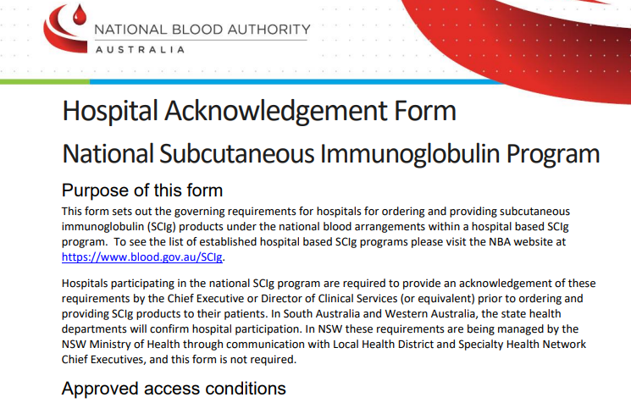
Health service eligibility criteria
    The hospital must be approved by the NBA to commence a hospital based SCIg program
      The NBA - Hospital Acknowledgement Form National Subcutaneous Immunoglobulin Program must be completed and includes governance requirements for the program.
      SCIg-hospital-acknowledgment-form-2021.pdf (blood.gov.au)
      Completed form must be returned to the to the National Blood Authority –
      Email: iggovernance@blood.gov.au
      Fax: (02) 6151 5235 (Attention: Ig Governance)
      Governance Requirements:
Quality Assurance
Clinical oversight
Equipment and facilities
Education and training
Regular review
Supply of product
Reporting unused, discarded, spoilt/broken product

Slide 13
Governance – quality assurance & clinical oversight
Quality assurance
  Policies and procedures that provide quality assurance and monitor compliance for the management and use of SCIg in line with the National Safety and Quality Health Service (NSQHS) Standards, particularly Clinical Governance Standard (1) and Blood Management Standard (7).
      Who will write the policies/procedures?
      Who will monitor compliance?
  Clinical oversight
  A recognised treatment program for the management and use of immunoglobulin for the relevant indications, including an appropriate supervising specialist
  Must provide ongoing clinical oversight and support for participating patients
  The responsible clinician must consider patient suitability for the self-management and administration of SCIg to ensure appropriate management and use of SCIg product

Slide 14
Governance – equipment, facilities, education & training
  Equipment and facilities
  Must ensure that patients have access to all necessary equipment and consumables to administer the product, at no additional cost to patients
    What equipment will be used?
    Where will the patient education take place?
    Where will the patient get the necessary consumables from?
    Who will ensure the patient has everything they need?
  Education and training
  Must provide education and training for staff and patients
    Who will provide the staff education?
    Who will be responsible for patient education?
    Will education be one on one, or can it be a group session?

Slide 15
Governance – review and product supply
  Regular review
  Assessing clinical benefit of treatment for ongoing therapy should be conducted at periods specified by the responsible clinician in line with the Criteria
  Patients should be encouraged to maintain a diary to record SCIg product use and any adverse reactions, as well as collection and management of product as an aid for the clinician at the assessment
  Supply of product
  Orders for SCIg for authorised patients must be managed via BloodSTAR, or alternative arrangements if necessary.
  The amount of SCIg supplied to a patient should not exceed more than is required for treatment for two months
  Supply and dispensing of SCIg product to patients must be in accordance with relevant state/territory legal requirements
    SCIg is an S4 medication and must be dispensed by a pharmacist
    Requires a medication prescription; must provide a copy to the pharmacy
    BloodSTAR and BloodNET for traceability

Slide 16
Governance – reporting unused, discarded, spoilt/broken product
  Reporting unused, discarded, spoilt/broken product
Patients supplied with SCIg will be expected to report details of unused, discarded or spoilt/broken product to the hospital, to be reported by the hospital through BloodNet
      Who will the patient report this to?

Slide 17
Other considerations
    Cost benefit analysis – business case to support the decision (template available on Blood Matters SCIg program, tools and resources webpage SCIg program, tools and resources (health.vic.gov.au)
    Clinical engagement – medical, nursing and pharmacy staff
    Space – is there a suitable ward/location for patient education?
    BloodSTAR registration, education

Slide 18
Putting the SCIg pieces together
Patient population to support SCIg program
Stakeholder engagement
Staff identified to oversee SCIg program
Select and consent patients for SCIg
Health service obtains Executive approval to commence a SCIg program
Source equipment and consumables
Commence SCIg program
Document development
Provide patient education
Submit and obtain NBA approval
BloodSTAR access

Slide 19
Patient selection
Willingness to participate in the program
Patient or carer with the dexterity and ability to administer SCIg
Patients with difficult IV access
Patients who have significant or frequent reactions to IVIg
Those who travel a long way to get treatment
Patients who are time poor for any reason and find it difficult to attend for IVIg
Patients who may be more compliant with SCIg than IVIg – assess reason for non-compliance

Slide 20
Contraindications to SCIg*
Anaphylactic or severe systemic reactions to immunoglobulin (Ig)
Extensive skin conditions- psoriasis, eczema
Cognitive impairment
Poor manual dexterity, decreased hand grip, tremors, poor eyesight
IgA deficiency – discuss with immunologist
Hizentra® AU - patients with known hyperprolinemia (type I or II)
Hizentra® - patients with known hyperprolinemia (type I or II)
Cuvitru® - patients with known reactions to glycine and patients with IgA deficiency
Xembify®°- patients with known reactions to glycine and patients with IgA deficiency
* Refer to product information
°Xembify® will be available from January 2024

Slide 21
Products and vials
Issue | Hizentra® AU* | Hizentra® * | Cuvitru®* | Xembify®*°
Plasma source | Local | Imported | Imported | Imported
Stabilizer | Proline | Proline | Glycine | Glycine
Concentration | 20% | 20% | 20% | 20%
Storage | <25°C (do not freeze) | <25°C (do not freeze) | 2 – 8°C (do not freeze) | 2 – 8°C (do not freeze) May be stored ≤25°C for up to 6 months any time prior to expiry date
Vial sizes | 1g (5mL), 2g (10mL), 4g (20mL) | 1g (5mL), 2g (10mL), 4g (20mL), 10g (50mL) | 1g (5mL), 2g (10mL), 4g (20mL), 8g (40mL), 10g (50mL) | 1g (5mL), 2g (10mL), 4g (20mL), 10g (50mL)
Rate | 1st infusion - 20 mL/hr/site 2nd & 3rd infusions - 35mL/hr/site Subsequent infusions based on patient comfort & tolerability | 1st infusion - 20 mL/hr/site 2nd & 3rd infusions - 35mL/hr/site Subsequent infusions based on patient comfort & tolerability | 1st & 2nd infusions - 10mL/hr/site if tolerated increase every 10 min to a max of 20mL/hr/site Subsequent infusions based on patient comfort & tolerability | 1st & 2nd infusions - 25mL/hr/site Subsequent infusions –gradually increase to 35mL/hr/site based on patient comfort & tolerability
Frequency | Individualised | Individualised | Individualised | Individualised
* Refer to Product information
°Xembify® will be available from January 2024

Slide 22
Ordering SCIg - BloodSTAR
Patient needs to meet criteria for SCIg and MO needs authorisation from Lifeblood via BloodSTAR
Nursing (or delegated) staff order the product using a planning sheet in BloodSTAR. This is how the blood bank or pharmacy in the health service are notified of the order
Pharmacy or blood bank order the product from Lifeblood via BloodNET
Product is delivered to pharmacy or blood bank
For inpatient care, the product can be issued to the ward by blood bank (or pharmacy)
For home-care the product must be dispensed by pharmacy (S4 medication)
In some cases, the product can be ordered by treating facility and delivered to a rural hospital/pharmacy (by agreement)
Need to advise the blood bank/pharmacy what vial sizes are needed for the patient, so the right dose can be given on a weekly basis

Slide 23
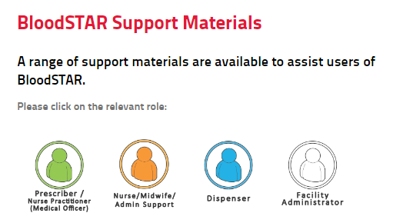
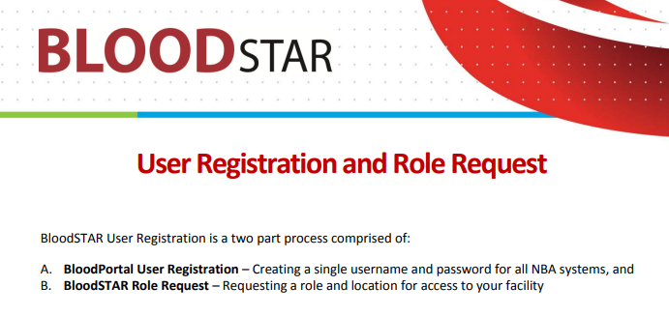
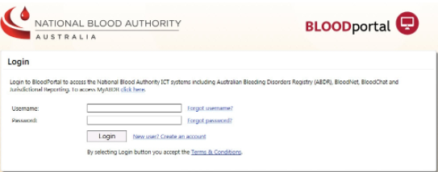
BloodSTAR
Two part process
BLOODportal user registration – create username and password for all NBA systems
BloodSTAR role request – requesting a role and location for access to your facility
BloodSTAR support materials
https://www.blood.gov.au/bloodstar-support-materials
https://www.blood.gov.au/bloodportal
BloodSTAR-User-Tip-Sheet-Registration-and-Role-Request-Dec2018.pdf

Slide 24
Ordering SCIg flow
Patient meets SCIg criteria
Specialist requests SCIg via BloodSTAR
Lifeblood approval
MO completes script for SCIg
Nurse (or delegate) completes SCIg planning sheet (BloodSTAR)
Nurse (or delegate) provides a copy of the prescription to pharmacy
Blood bank or pharmacy complete dispensing of SCIg in BloodNET
Blood bank can dispense for inpatient use only
Pharmacy complete S4 dispensing for home use

Slide 25
Patient education
Hand washing & aseptic technique
Pumps & consumables
Injection site selection & care
Ordering & collection of product & consumables
Transport & storage of product
Checking, preparing and drawing up the product
Priming infusion set & needle insertion technique
Dose and rate calculations (+/- VersaRate – when using the EMED system)
Adverse reaction management
Documentation of infusion & report wastage

Slide 26
Equipment: pumps & consumables
Cooler bag/esky for transport (ice brick)
Infusion pump
Subcutaneous infusion set
Sharps container
Antibacterial wipes or soapy water (to clean a work surface or infusion mat)
Alcohol swabs
Luer lock syringe(s)
Drawing up needle(s)/vented dispensing pin
Adhesive dressing
Small band aid/gauze/cotton ball
Infusion diary/Infusion App

Slide 27
Subcutaneous infusion sets
Item | EMED | HIgH-Flo | Neria
Needle gauge | 24G & 27G | 24G & 26G | 27G
Needle length | 4mm, 6mm, 9mm, 12mm | 4mm, 6mm 9mm,12mm,14mm | Steel: 8mm, 10mm, Soft: 9mm
Tubing | 36 inch / 70cm | 20 inch extension set available | Single lumen: 80cm Multiple lumens: 90cm Soft cannula: 110cm
Needle sets | 1, 2, 3, 4 lumens | 1, 2, 3, 4, 5, & 6 lumens | Steel: 1, 2, 4 lumens Soft cannula: single lumen
Wings | Y | Y | Y
Adhesive dressing | Dressing included | Dressing included | Integrated dressing

Slide 28
Subcutaneous infusion sets cont…
Item | Butterfly needle Terumo | BD Saf-T-Intima
Needle gauge | 21G, 23G, 25G | 20G, 22G, 24G
Needle length | 19mm | 19mm
Tubing | 30cm, 9cm | Short
Needle sets | Single lumen | Single lumen
Wings | Y | Y
Adhesive dressing | Dressing not included | Dressing not included

Slide 29
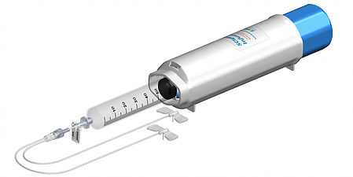
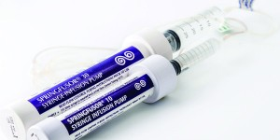
Pumps
Emed - SCIg 60 infusion system https://www.emedtc.com/products
Spring driven
50/60mL BD syringe
Rate controller - VersaRate Plus | EMED Technologies (emedtc.com)
Springfuser ® syringe infusion pump - 10,30 or 50
Go Medical Industries Pty Ltd - Springfusor & FCT
Spring driven
10ml, 30ml or 50ml Syringe (syringe size varies with pump size)
Flow rate control tubing and syringe (purchased separately)
Can be used with any needle system

Slide 30
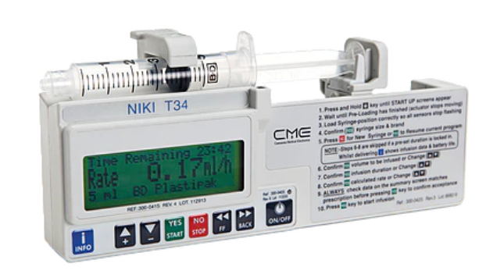
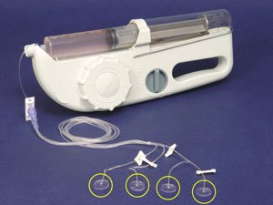
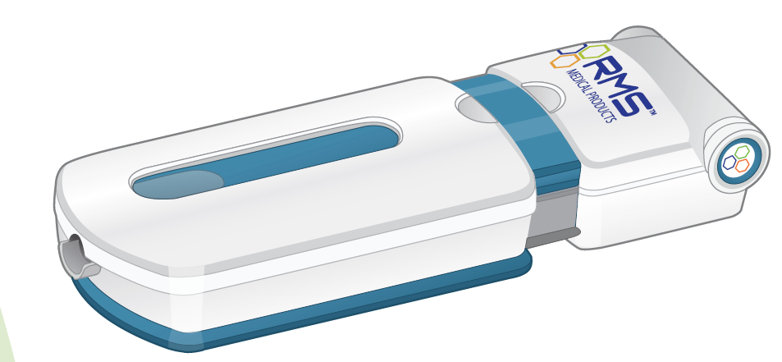
Other pumps
Niki T34™
Battery powered
Programmable – rate control
Up to 50mL options
FREEDOM60®
Spring driven
Uses flow control tubing
60mL BD syringe
FreedomEdge®
Spring driven
Uses flow control tubing
20-30 mL syringe

Slide 31
Documentation
Record in the patient infusion diary/infusion App/medical record:
Product name
Batch number
Dose
Volume
Infusion time
Infusion site
Infusion rate
Symptoms/side effects

Slide 32
Questions to you
What support/assistance do you need?
Business case
Policy/procedure
Staff education and checklist
Patient education and checklist
FAQs

Slide 33
Further information:
Contact: Anne Graham
Blood Matters Project Nurse
Phone: 03 9694 0126
Blood Matters SCIg information, tools and resources:
https://www.health.vic.gov.au/patient-care/subcutaneous-immunoglobulin-scig-access-program

Slide 34
Acknowledgement
Australian governments fund the Australian Red Cross Lifeblood to provide blood, blood products and services to the Australian community.

Slide 35
Accessibility
  To receive this presentation in another format phone 03 9694 0102, using the National Relay Service 13 36 77 if required, or email Blood Matters <bloodmatters@redcrossblood.org.au>.
  Authorised and published by the Victorian Government, 1 Treasury Place, Melbourne.
  © State of Victoria, Australia, Department of Health, July 2023.
  ISBN 978-1-76131-192-5 (pdf/online/MS word)
  Available at Blood Matters Program <https://www.health.vic.gov.au/patient-care/blood-matters-program>

